Slide 1
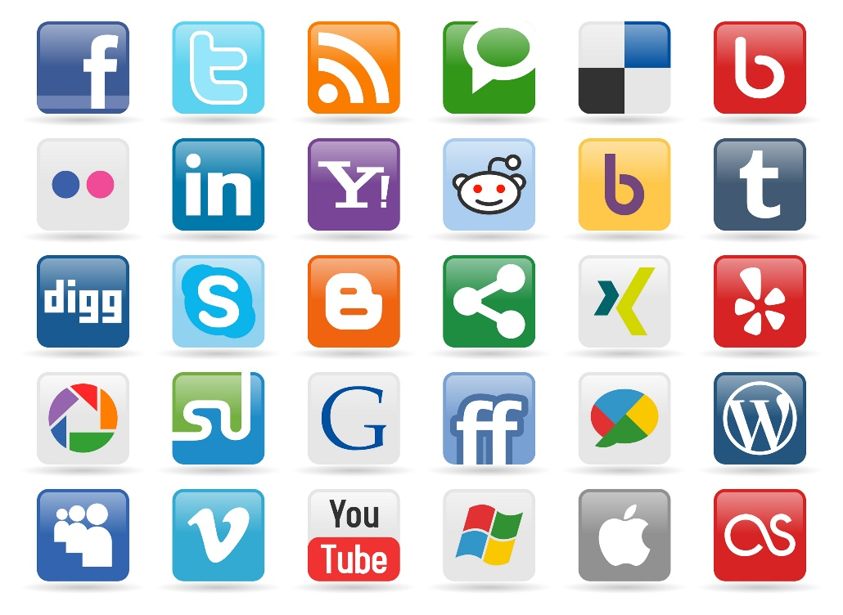

Introduction
SOCIAL
MEDIA
MINING

Slide 2
Dear instructors/users of these slides: Please feel free to include these slides in your own material, or modify them as you see fit. If you decide to incorporate these slides into your presentations, please include the following note:
R. Zafarani, M. A. Abbasi, and H. Liu, Social Media Mining: An Introduction, Cambridge University Press, 2014.
Free book and slides at http://socialmediamining.info/
or include a link to the website: http://socialmediamining.info/

Slide 3
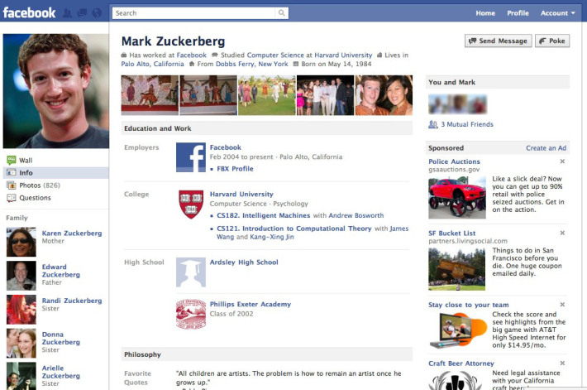
Facebook
How does Facebook use your data?
Where do you think Facebook can use your data?

Slide 4
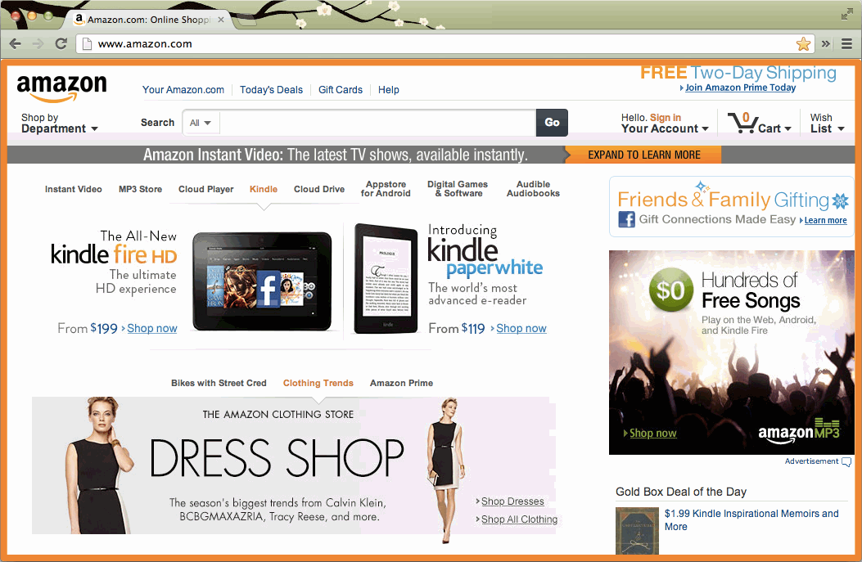
What about Amazon?

Slide 5
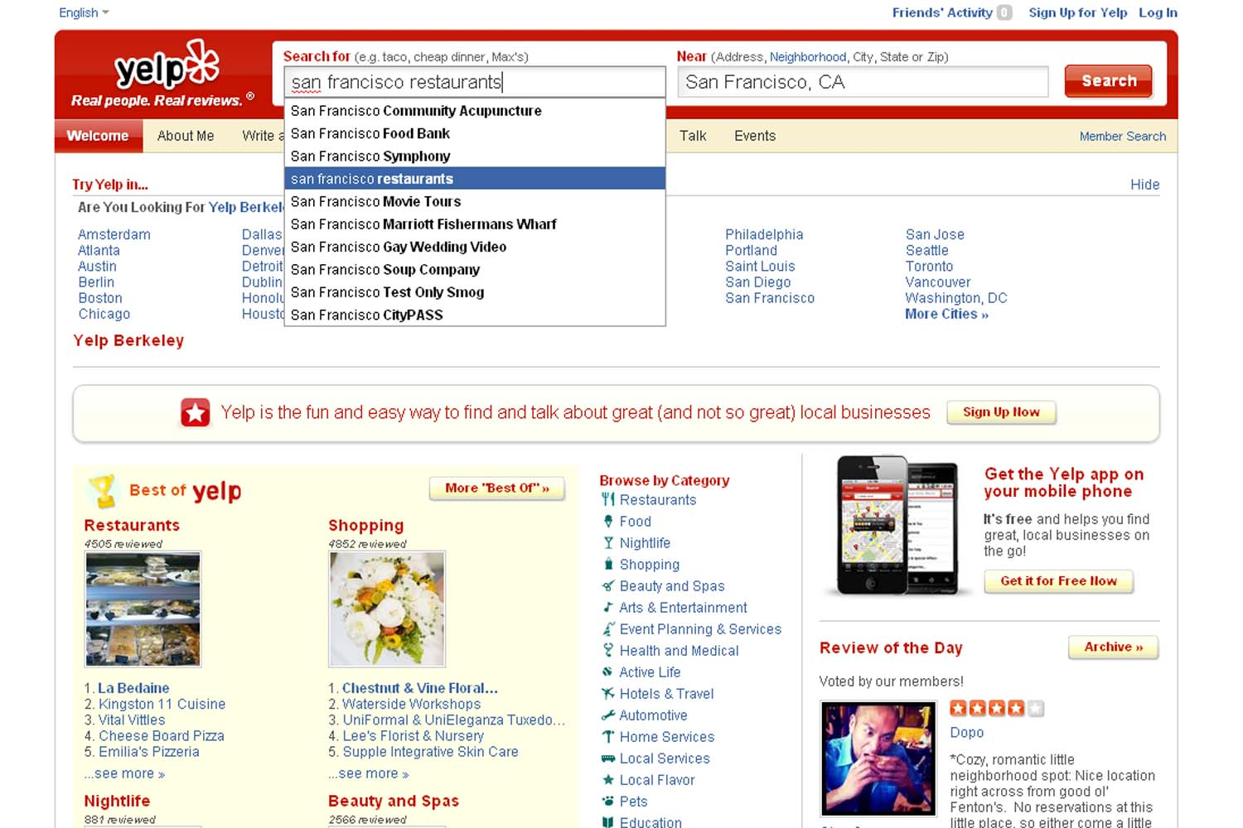
Yelp?

Slide 6
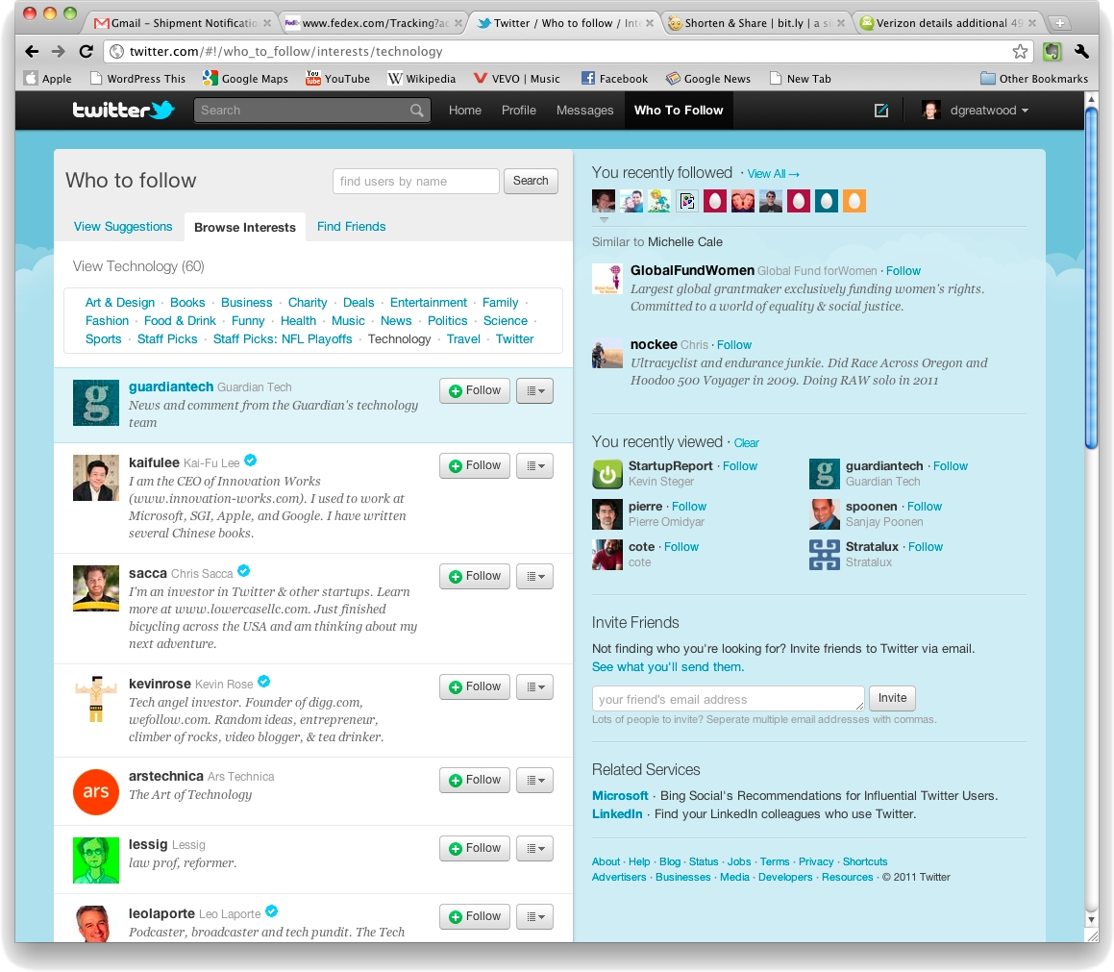
Or Twitter?

Slide 7
Course Information
Social Media Mining
Line number:
CIS 700
Priority for students that have taken CIS 787
See blackboard for more information / Follow the procedure to obtain my signature
Classroom and Hours:
CST 3-216, MW 3:45 – 5:05 PM
Blackboard:
Everything (slides/homeworks/projects/etc.)

Slide 8
Introduction
Instructor:
Reza Zafarani (rzafaran@syr.edu)
Office Hours (Starting Jan 28th):
Thursday 9:00 - 10:00am, CST 4-279
Other times: by appointment only

Slide 9
Objectives of Our Course
Understand social aspects of the Web
Social Theories + Social media + Mining
Learn to collect, clean, and represent social media data
How to measure important properties of social media and simulate social media models
Find and analyze communities in social media
Understand how information propagates in social media
Understanding friendships in social media, perform recommendations, and analyze behavior
Study or ask interesting research issues
e.g., start-up ideas / research challenges
Learn representative algorithms and tools

Slide 10
Course Information
Prerequisites:
CIS 787 – Analytical Data Mining
Data Structures and Algorithms
Search/Sort algorithms
Graphs
Graph Algorithms (Traversal, MST, shortest-paths)
Time/Space Complexity
Programming Skills: Java, basic understanding of MATLAB is a plus
E.g., Being able to crawl a website with Java
E.g., Computing eigenvalues of a matrix with MATLAB
Basic knowledge of probability, statistics, calculus, and linear algebra
Expectation, variance, standard deviation,
Eigenvalue computation, determinants, characteristic equation
Basic differentiation, integration, and differential equations

Slide 11
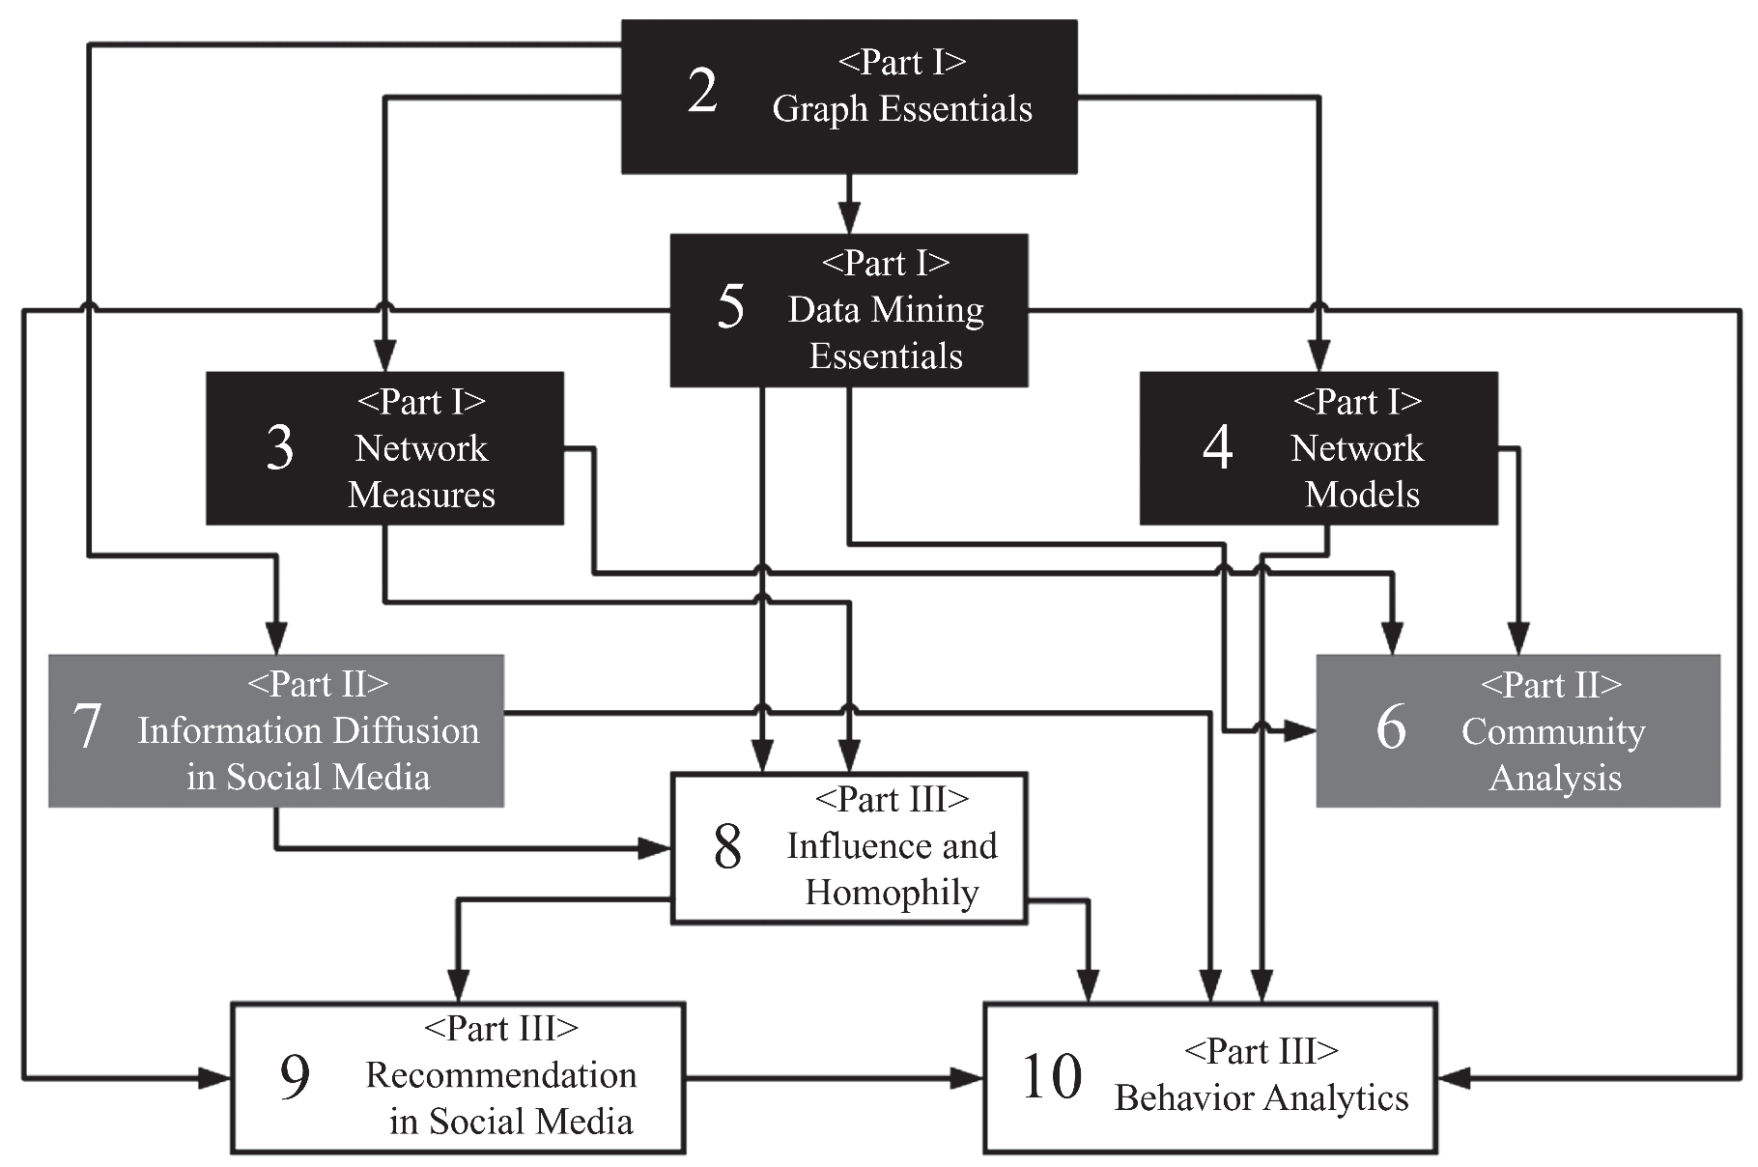
Overview – Dependency Graph

Slide 12
Weekly Schedule and Syllabus
The weekly schedule will be available on blackboard

Slide 13
Course Workload and Evaluation
A lot of work is expected from you! Think twice if it does not fit your schedule or match your expectation.
Lectures
Experienced researchers or practitioners may be invited as guest instructors for specific topics.
Homework assignments (15%) – 4 HWs
Conceptual; deep thinking required
Projects (20%)
Two projects
first project is individual, second is group project
3 Exams (50%) – 3/6: highest, 2/6: medium, 1/6: lowest
Quizzes (15%) – 9-10 quizzes; after chapters/topics
Late penalty:
Exponential penalty: -50% first day, -75% second day, no points on or after the third day.

Slide 14
Academic Integrity
Please see:
http://supolicies.syr.edu/ethics/acad_integrity.htm
You are encouraged to form groups to solve problems and coding assignments; however, when writing, write in your own words and provide your own solutions.

Slide 15

Text and Reference Books
Primary Reference:
Social Media Mining, Reza Zafarani, Mohammad-Ali Abbasi, Huan Liu, Cambridge University Press 2014,
Available at http://socialmediamining.info or amazon.com

Slide 16
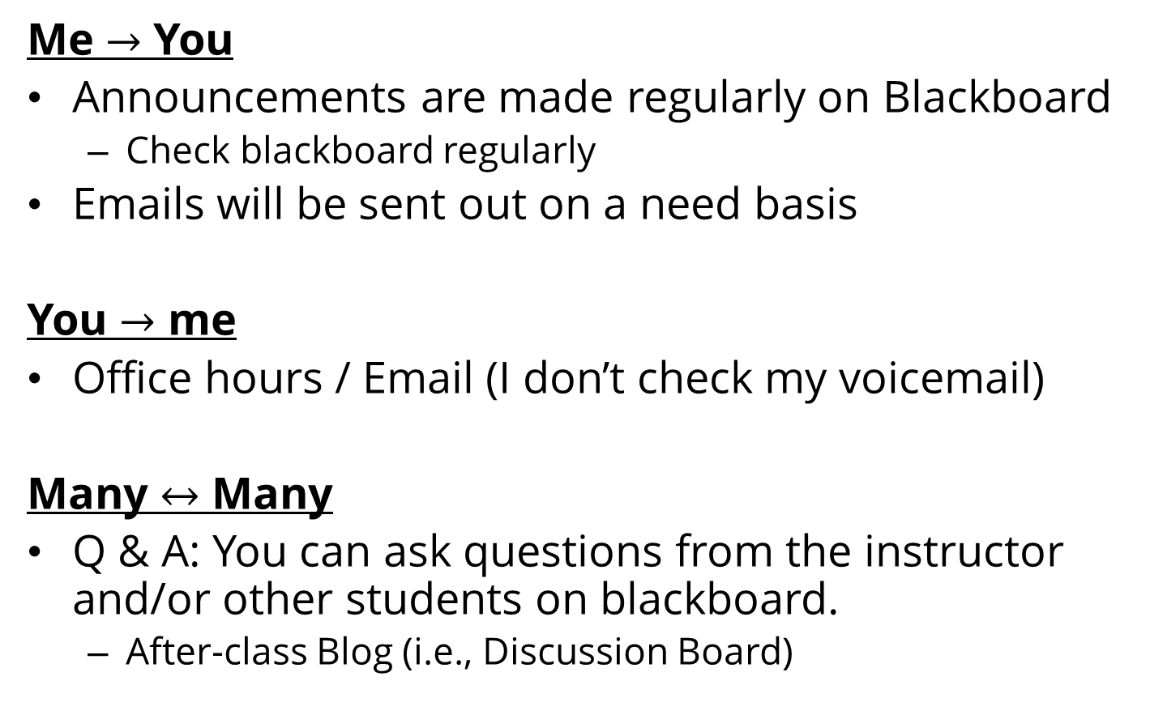
Communication Channels and Schedule
Me $→$ You
Announcements are made regularly on Blackboard
Check blackboard regularly
Emails will be sent out on a need basis
You $→$ me
Office hours / Email (I don’t check my voicemail)
Many $↔$ Many
Q & A: You can ask questions from the instructor and/or other students on blackboard.
After-class Blog (i.e., Discussion Board)

Slide 17
Feedback
A class survey today
One in the middle of the semester
At the end of each of classes:
All surveys are anonymous
Topic | Yes | No
Topic 1 | X
Topic 2 |  | X
Topic 3 | X
Topic 4 |  | X
“the equation on slide 5” |  | X

Slide 18
Social Media

Slide 19
Definition
Social Media is the use of electronic and Internet tools for the purpose of sharing and discussing information and experiences with other human beings in more efficient ways.

Slide 20
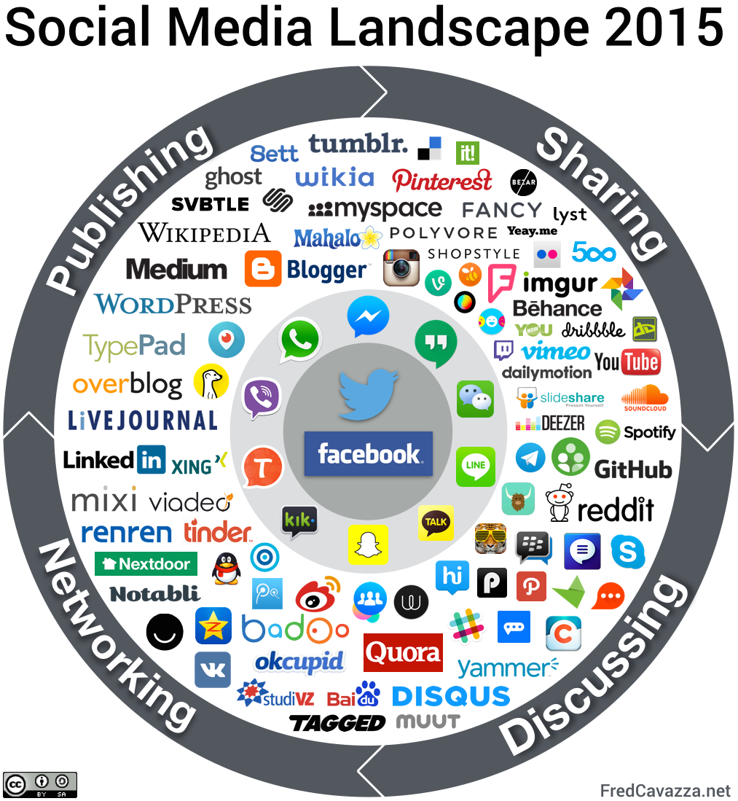
Notes:
Image Source: http://www.fredcavazza.net/2008/06/09/social-media-landscape/

Slide 21
Social Media: Examples
A wiki article
Web reviews and ratings of a popular pizza place in your city
E.g., Yelp.com
An online social network of your professional contacts
E.g., Facebook.com, LinkedIn.com
An iPhone application that informs you where parking is likely available
FasPark

Slide 22
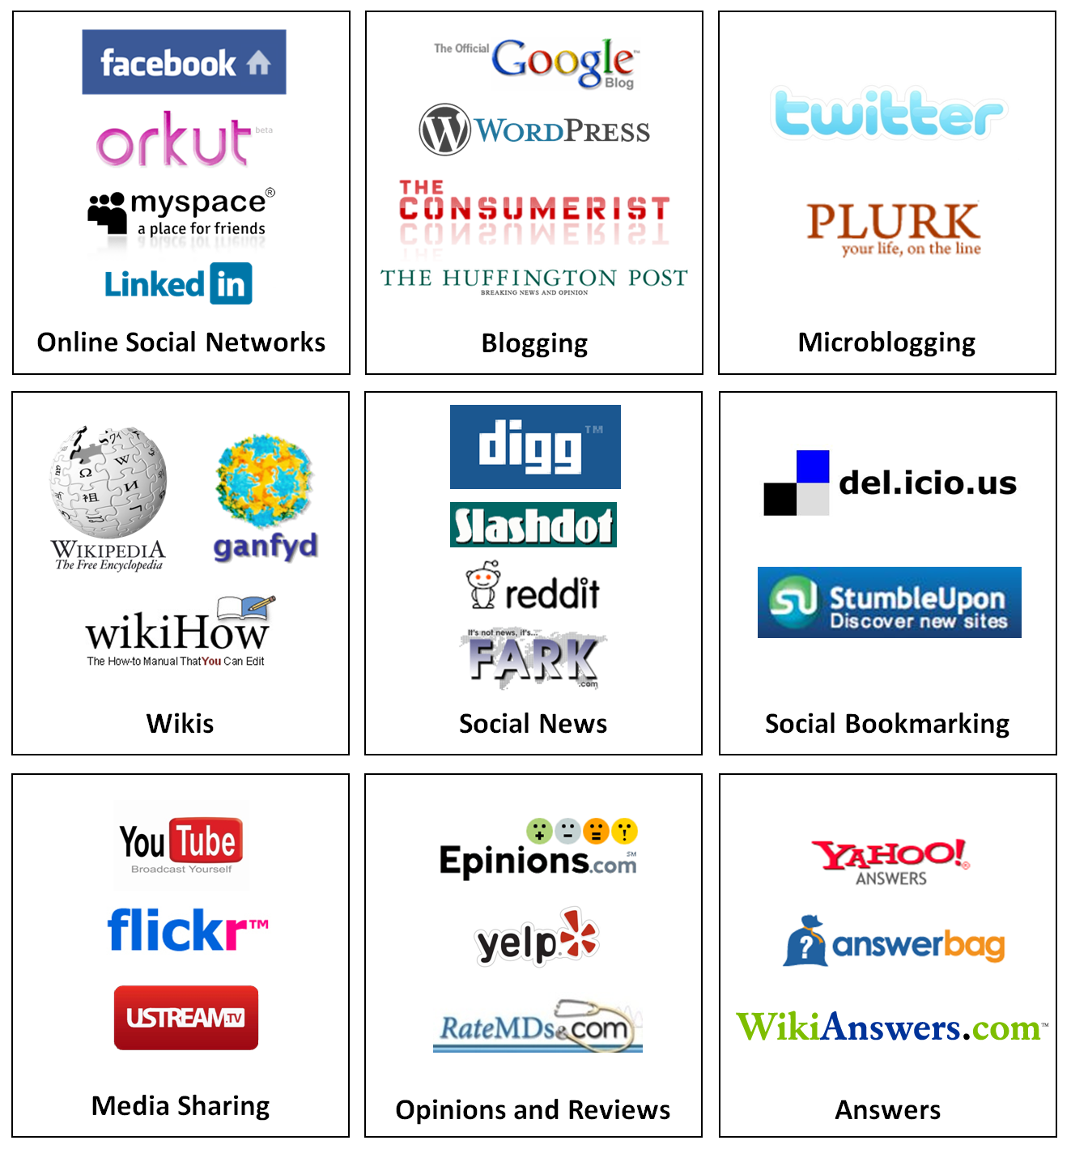
Types of Social Media
Online Social Networking
Publishing
Blogging
Wiki
Micro blogging
Social News
Social Bookmarking
Media Sharing
Video Sharing
Photo Sharing
Podcast Sharing
Opinion, Review, and Ratings Websites
Answers
Entertainment

Slide 23
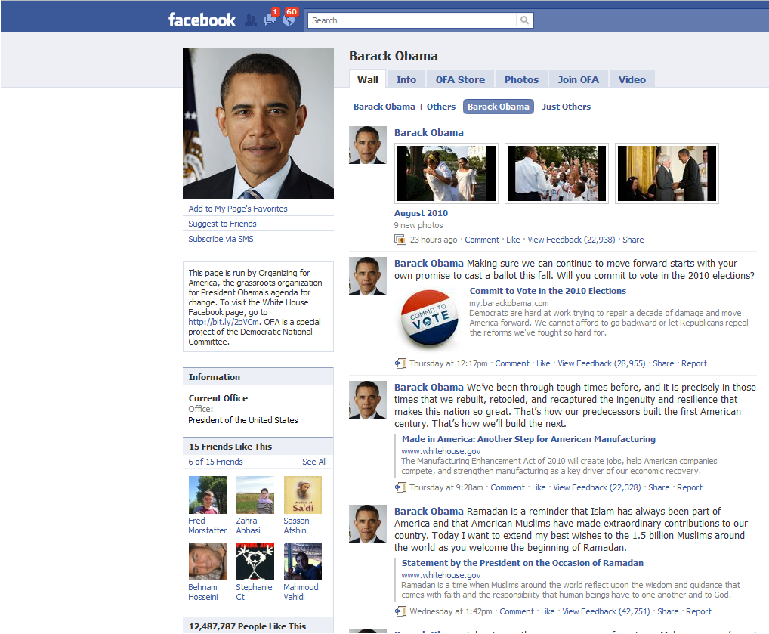
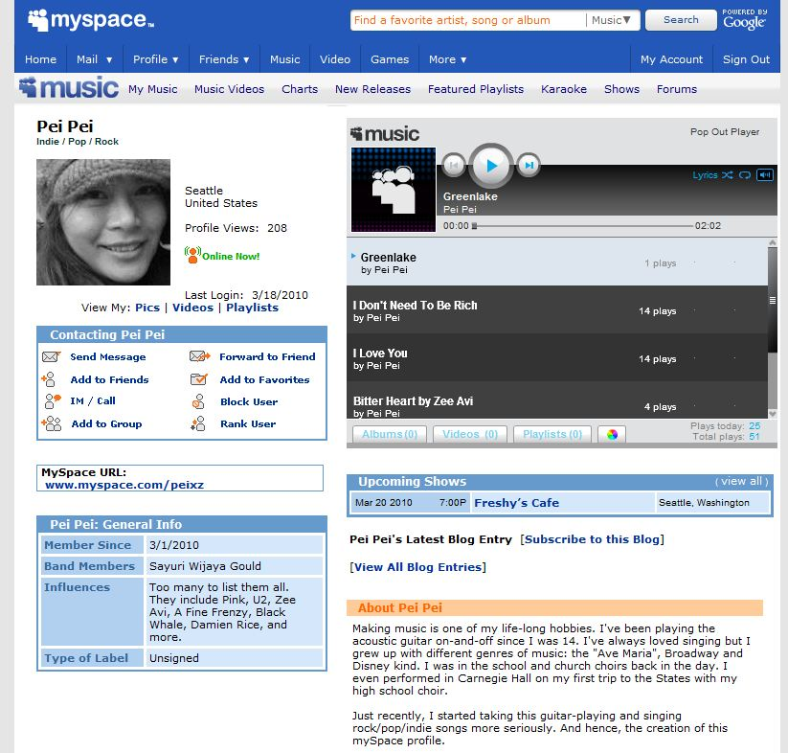
Online Social Networking
Online Social Networks are web-based services that allow individuals and communities to connect with real world friends and acquaintances online
Interactions
Friendship interaction
Friends, like, comments, …
Media Sharing
Sending and receiving messages
Examples
Facebook.com
MySpace.com
Bebo.com
Orkut.com

Slide 24
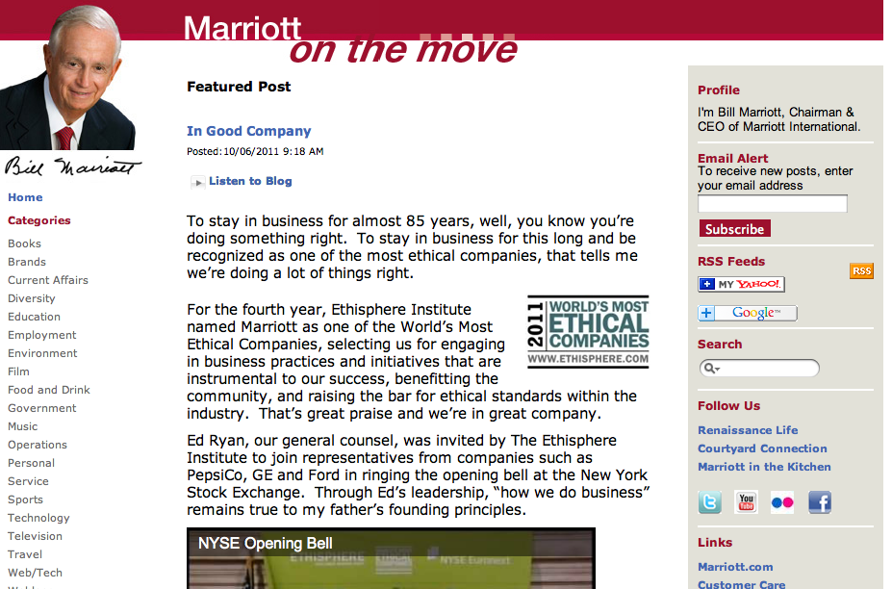
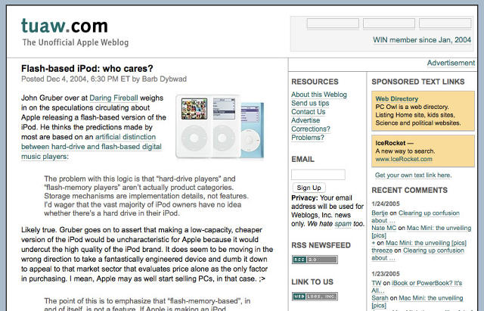
Blogging
A blog is a journal-like website for users, a.k.a. bloggers, to contribute textual and multimedia content, arranged in reverse chronological order
Maintained both individually or by a community
See a tutorial at KDD http://videolectures.net/kdd08_liu_briat/
Usages:
Sharing information and opinions with friends and strangers
Disseminating subject-specific content
Who is the influential http://videolectures.net/wsdm08_agarwal_iib/

Slide 25
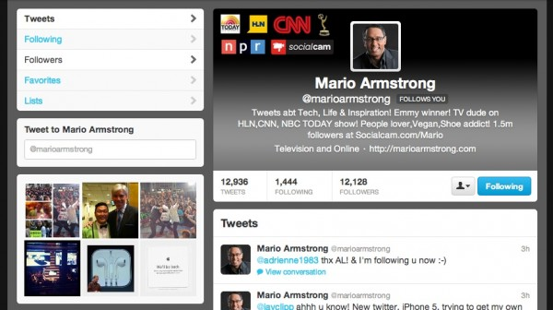
Microblogging
Microblogging can be considered as a counterpart to blogging, but with limited content
Usage
communication medium
social interaction
citizen journalism
Service Providers:
Twitter
Google buzz

Slide 26
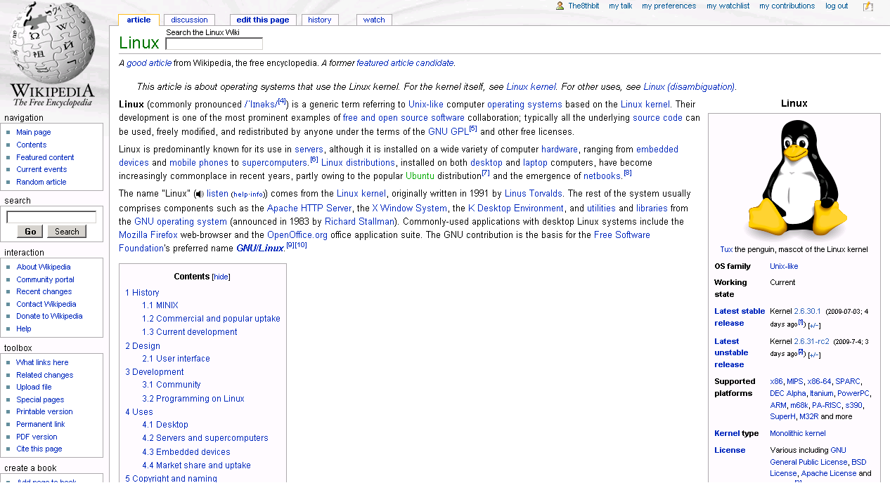
Wiki
A wiki is a collaborative editing environment that allows users to develop Web pages using a simplified markup language
Wikipedia allows interested individuals to collaboratively develop articles on a variety of subjects.
Using the wisdom of crowds effectively, it has become a comprehensive repository of information useful to a variety of individuals

Slide 27
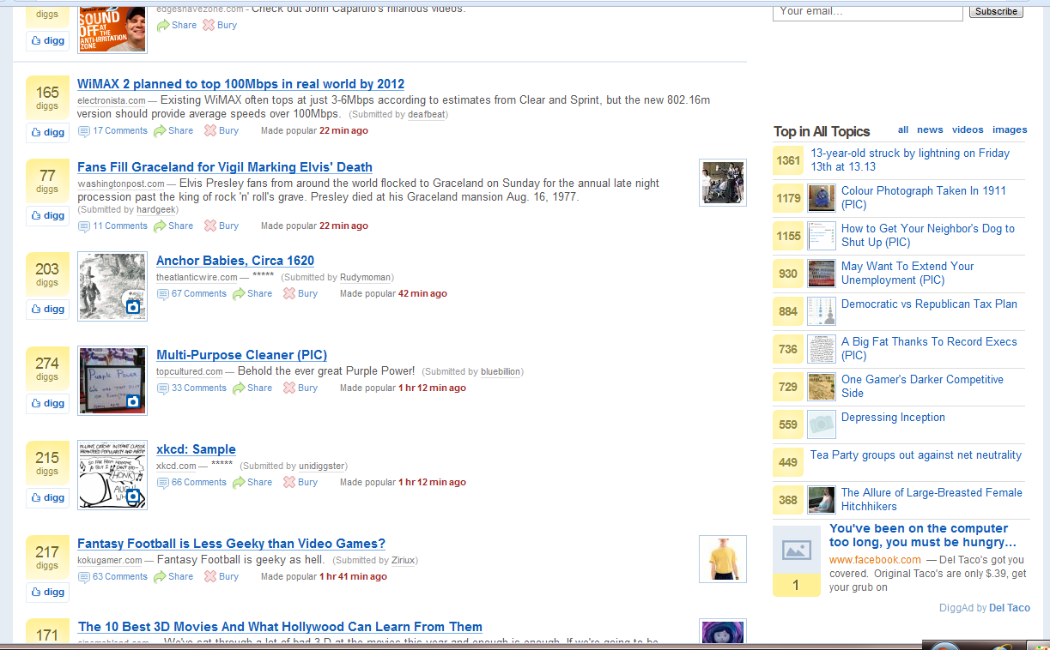
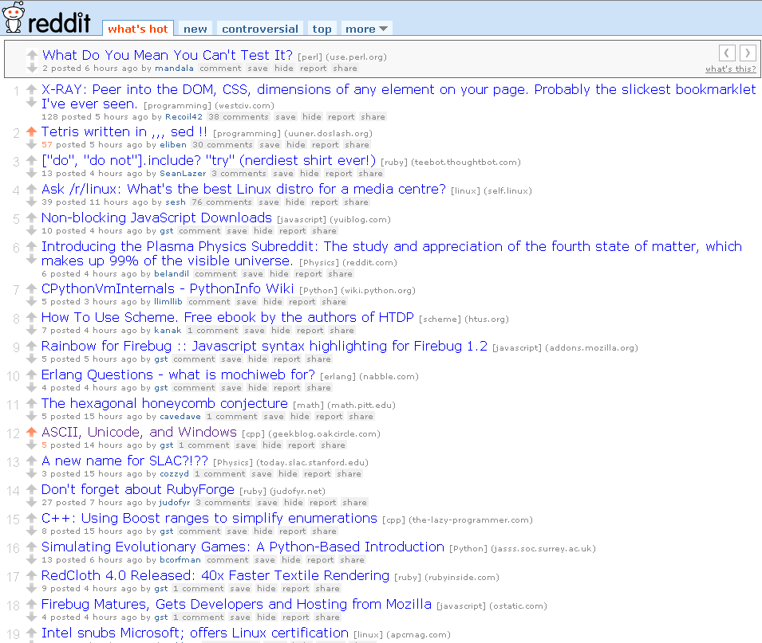
Social News
Social News refers to the sharing and selection of news stories and articles by a community of users.
Users can share articles that they believe would interest the community
Samples:
Digg.com
Slashdot
Fark
Reddit

Slide 28
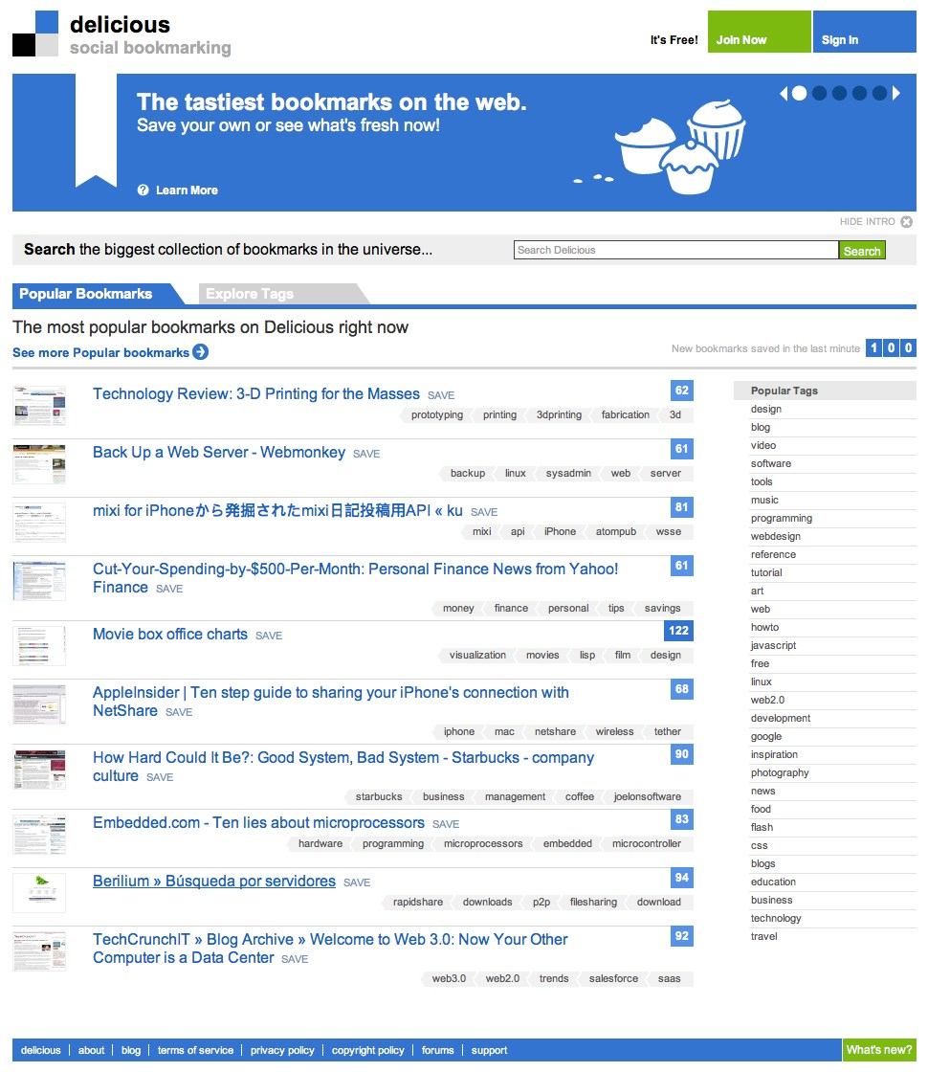
Social Bookmarking
Social Bookmarking sites allow users to bookmark web content for storage, organization and sharing.
These bookmarks can be tagged with metadata to categorize and provide context to the shared content, allowing users to organize information making it easy to search and identify relevant information.
Samples
Delicious.com
StumbleUpon.com

Slide 29
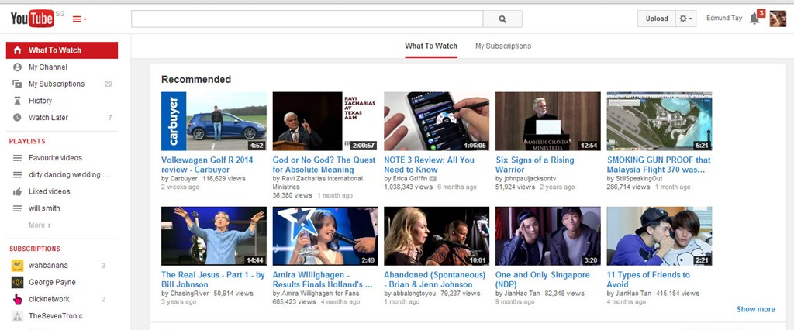
Media Sharing
Media sharing is an umbrella term that refers to the sharing of a variety of media on the web.
Users share such multimedia content of possible interest to others
Samples:
Video Sharing:
YouTube.com
Photo Sharing:
Flickr.com, picasa.com
Document Sharing:
Scribd.com, Slideshare.com
Livecasting:
Justin.tv, Ustream.com

Slide 30
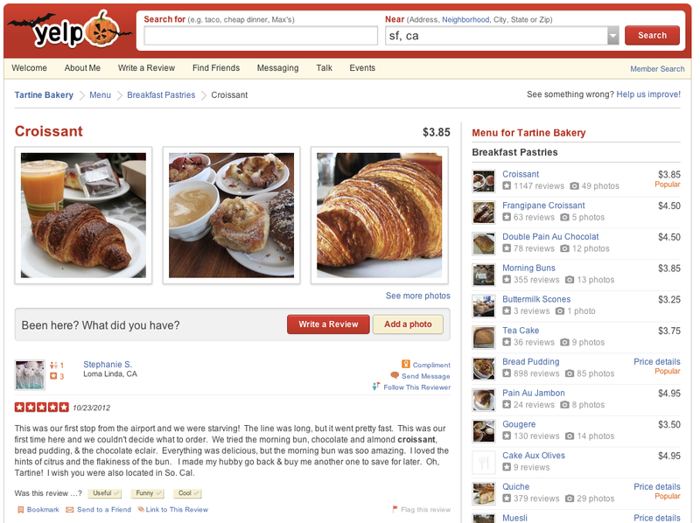
Opinion, Review, and Ratings Websites
Opinion, review, and ratings websites are websites whose primary function is to collect and publish user-submitted content in the form of subjective commentary on existing products, services, entertainment, businesses, places, etc. Some commercial sites may serve a secondary purpose as review sites by publishing product reviews submitted by customers.
Examples
Cnet.com
Epinions.com
yelp.com
tripadvisor.com

Slide 31
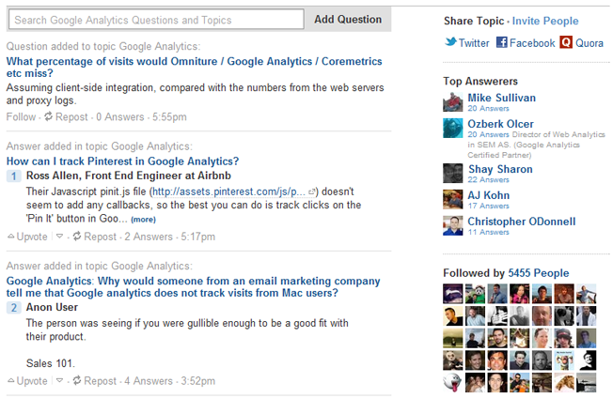
Socially-Provided Answers
In these sites, users who require certain guidance, advice or knowledge can ask questions. Other users from the community can answer these questions based on knowledge acquired from previous experiences, personal opinions or from relevant research.
Unlike review and opinion sites, which contain self-motivated contribution of opinions, answer sites contain knowledge shared in response to a specific query.
Samples:
WikiAnswers, Yahoo Answers, Quora

Slide 32
Main Characteristics
Participation
social media encourages contributions and feedback from everyone who is interested. It blurs the line between media and audience.
Openness
most social media services are open to feedback and participation. They encourage voting, comments and the sharing of information. There are rarely any barriers to accessing and making use of content – password-protected content is frowned on.
Conversation
whereas traditional media is about “broadcast” (content transmitted or distributed to an audience) social media is better seen as a two-way conversation.
Community
social media allows communities to form quickly and communicate effectively. Communities share common interests, such as a love of photography, a political issue or a favorite TV show.
Connectedness
Most kinds of social media thrive on their connectedness, making use of links to other sites, resources and people.

Slide 33
Social Media Mining is the process of representing, analyzing, and extracting meaningful patterns from social media data

Slide 34
Social Media Mining Challenges
Big Data Paradox
Social media data is big, yet not evenly distributed.
Often little data is available for an individual
Obtaining Sufficient Samples
Are our samples reliable representatives of the full data?
Noise Removal Fallacy
Too much removal makes data more sparse
Noise definition is relative and complicated and is task-dependent
Evaluation Dilemma
When there is no ground truth, how can you evaluate?

Slide 35
TODO Items
3 To-do items for you:
Follow the process on blackboard to obtain my permission
Familiarize yourself with blackboard
Take the course survey

